Slide 1

13 February 2017
Hackday Project “NLP Glassdoor”
13/02/17

Slide 2
Agenda
Project Scope
Project Architecture
Tools Used
Screenshots & Output
Business Value & Future
Appreciations

Slide 3
Project Scope
Identify the context of sentiments, for reviews posted on www.glassdoor.com for AppDirect.com;
Achieve this using Stanford NLP (Natural Language Processing)
Convert context using POS(Part Of Speech)
E.g. - The quality of work is good at AppDirect;
Design Phrase
Design Text Phrase
Design Entity & Relationship
Identify Terms & Frequency
Define Sentiment Classes - We defined few sentiment classes e.g.
Leadership
Quality of Work
Work Life Balance
Policies
Once the classification is achieved, we can simply generate reports for showcasing different kind of data, based on variety of Entity and classifications. Also the context & frequency can also be captured. This will be huge + for companies to validate the sentiment analysis for their company through any social website.
Download data from site
Convert data to excel
Terms & Frequency
Validation Entity Relationship
Phrases of Speech
Dictionary of Terms & Context
Showcase Reports
Data as Analytical
Segment Data in any format

Slide 4
Project Architecture
The field of Natural Language Processing (NLP) aims to convert human language into a formal representation that is easy for computers to manipulate. Current end applications include information extraction, machine translation, summarization, search and human computer interfaces
Part-Of-Speech Tagging (POS) aims at labeling each word with a unique tag that indicates its syntactic role, e.g. plural noun, adverb,
Manual Extract Data from Website in a excel file.
Glassdoor.com
Chunking, also called shallow parsing, aims at labeling segments of a sentence with syntactic constituents such as noun or verb phrase (NP or VP). Each word is assigned only one unique tag, often encoded as a begin-chunk (e.g. B-NP) or inside-chunk tag (e.g. INP).
Review Extraction
Convert the extracts to TXT file using JAVA
NLP ER Engine
NLP makes pairs with Parts of Speech & Entity Relations Algorithm and provides a CSV
The CSV export also provides context based matches between text and parts of speech recognition
Named Entity Recognition (NER) labels atomic elements in the sentence into categories such as “PERSON”, “COMPANY”, or “LOCATION”.
Semantic Role Labeling (SRL) aims at giving a semantic role to a syntactic constituent of a sentence
Reporting Engine
Create Graphs/Charts
The output(Using R) will help us create more context based reports & also can be used as source to generate Charts and Multi dimensional data reports
Language Models A language model traditionally estimates the probability of the next word being w in a sequence. We consider a different setting: predict whether the given sequence exists in nature, or not, following the methodology of (Okanohara & Tsujii, 2007). This is achieved by labeling real texts as positive examples, and generating “fake” negative text.
Semantically Related Words (“Synonyms”) This is the task of predicting whether two words are semantically related (synonyms, holonyms, hypernyms...)
Source: https://ronan.collobert.com/pub/matos/2008_nlp_icml.pdf

Slide 5
Tools Used
Code: https://github.com/badalb/company-review-sentiment-analysis

Slide 6
Screenshots & Output
Word Cloud
(Frequently Used Words)
Sentiment Graph
(Review Sentiments)

Slide 7
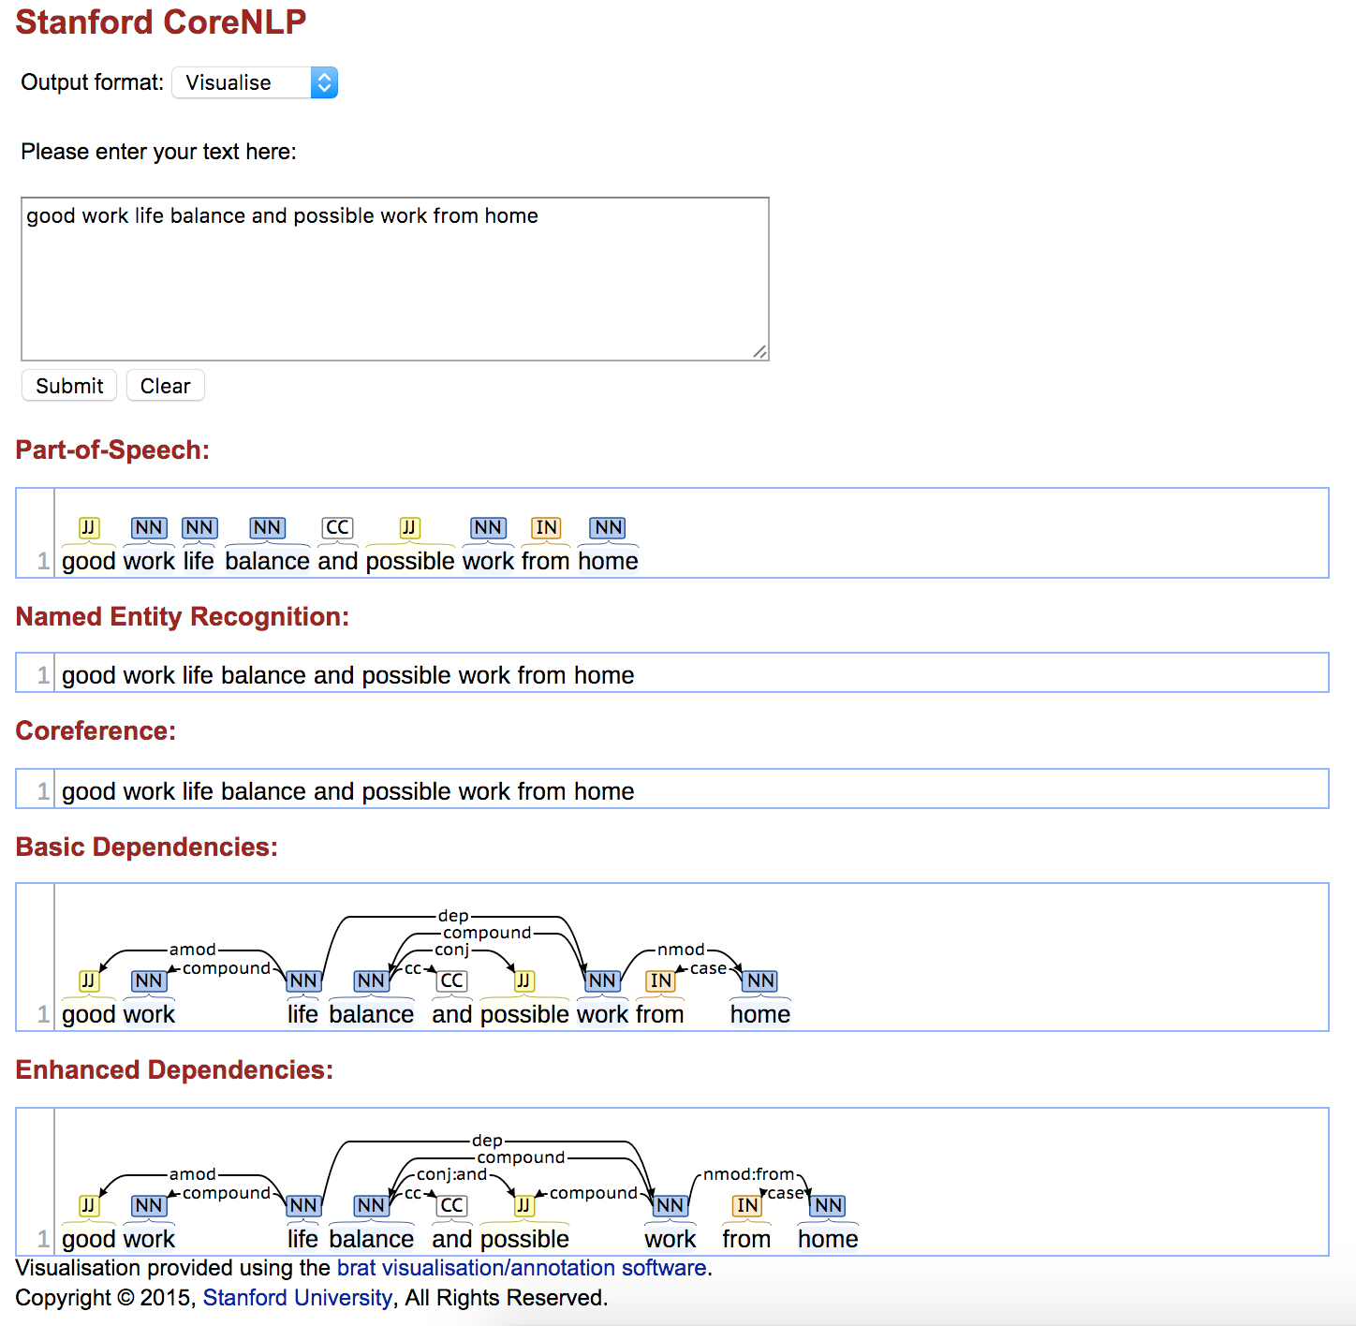
Screenshots & Output Cont.
1
2
3

Slide 8
Business Value & Future
How will this POC fir into AppDirect Goal -> CSAT?
Currently the model is able to identify the context and sentiment of the users posting reviews to Glassdoor.com, While this model can be enhanced to create some really interesting simulations and models to track CSAT for AppDirect.
Collect Information
Extract Feedback from Zendesk & Store as unstructured data store.
Sentiment Analysis
Collect customer sentiments and identify from feedback Positive, Negative & Neutral Responses
Generate Reports
Create Reports and Analysis for C-Level executives to identify: Critical Stats, Moderate State & Awesome States classification of clients

Slide 9
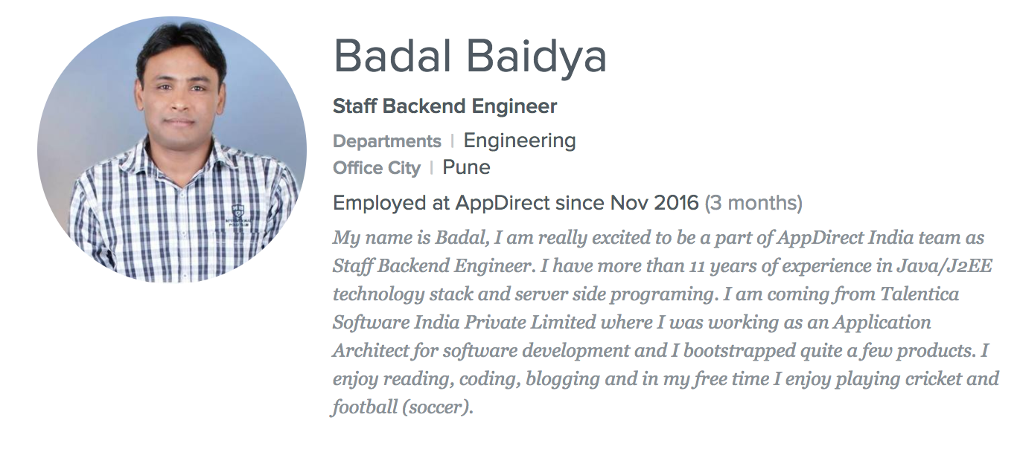
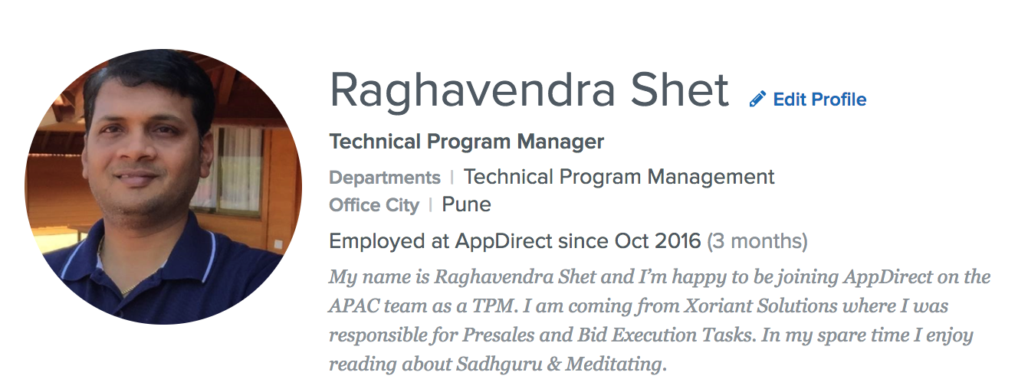
Thank You
AppDirect for the Opportunity
Deepak Chandani - Giving us the strength and believing in the concept, to proceed with maturity as PoC.
Hackday Organizers and other teams across the globe!
The Team

